Slide 1
Tg2576 Metabolomics analysis
Volcano plot
Tg0 vs WT0
MKH 10/7/2020

Slide 2
Using R software: Color coding based on p-values

Slide 3
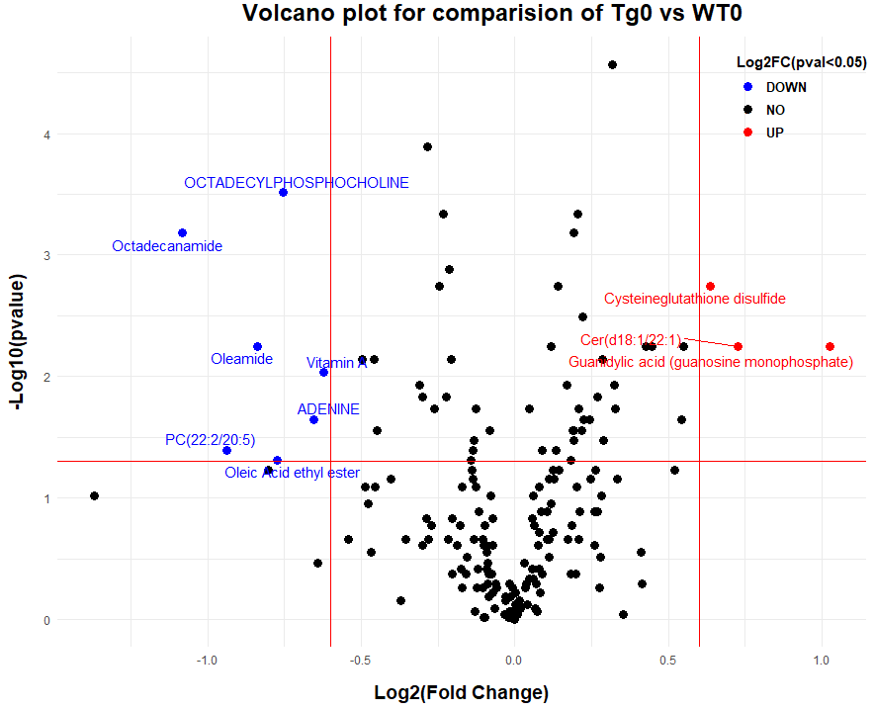
Using R software:
I adjusted lines based on log2FC > 0.6 & p-vale < 0.05
Color coding based on: log2FC if negative: DOWN, positive: UP, no changes: NO

Slide 4
Metaboanalyst A: FC threshold=1, p-value<0.05, I gave variables 'name to MetaboAnalyst A: FC threshold=1, p-value <0.05, I gave number for each variable to MetaboAnalyst A: FC threshold=2, p-value <0.05, I gave variables 'name to MetaboAnalyst A: FC threshold=2, p-value <0.05, I gave number for each variable to MetaboAnalyst
A
B
C
D

